Slide 1
Sections 2.1 Physical Protection and Attacks 2.2 – Locks and Keys
Digital security often begins with physical security…

Slide 2
Physical Protections and Attacks
Define physical security: the use of physical measures to protect valuables, information, or access to restricted resources.
Computer science views this as the following:
Protection by location
Physical intrusion detection
Hardware attacks
Eavesdropping
Physical interface attacks.

Slide 3
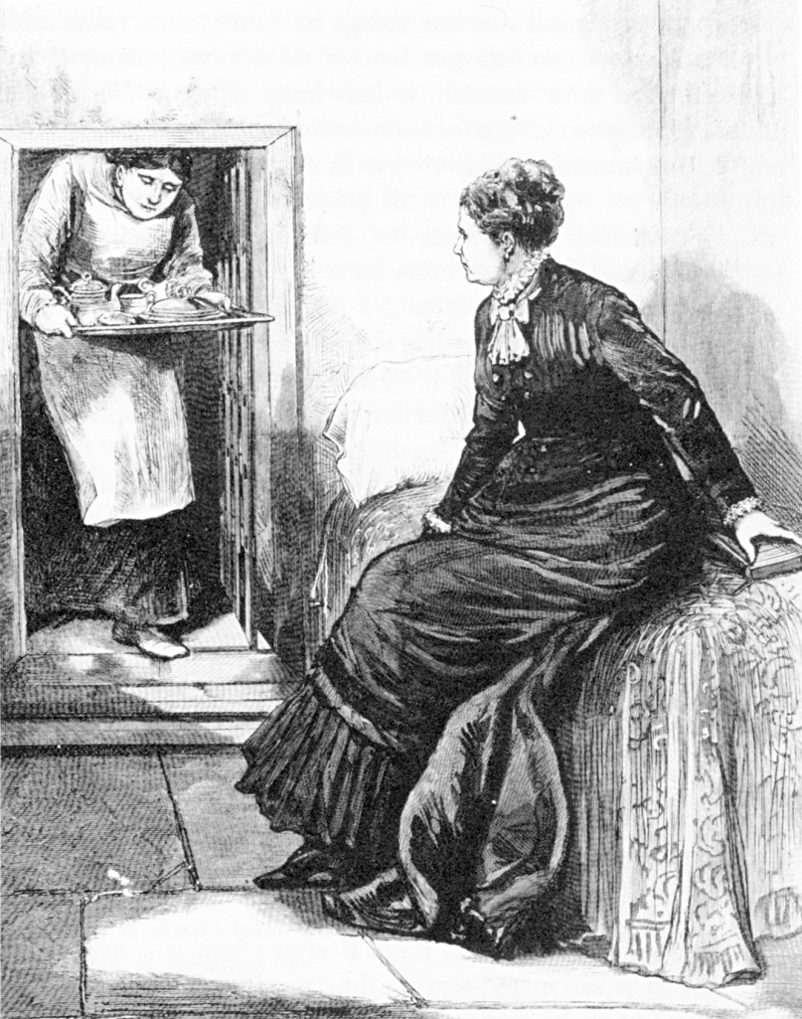
Legal Notice
Laws regarding lock picking vary significantly state-by-state
In most states the purchase and possession of dedicated lock picking tools is legal
But, penalties are raised significantly if you get caught using them in the commission of a crime
Public domain image from http://commons.wikimedia.org/wiki/File:Madame_Restell_in_jail.jpg

Slide 4
What Is Physical Security?
Any physical object that creates a barrier to unauthorized access
This includes, but is not limited to: locks, latches, safes, alarms, guards, guard dogs, doors, windows, walls, ceilings, floors, fences, door strikes, door frames and door closers

Slide 5
Is Physical Security An IT Concern?
You have been working hard to secure your network from cyber attacks
Redundant layers of antivirus programs, firewalls and intrusion detection systems should protect against every possible electronic method of entry
But what if an attacker gains access to the server room or network wiring closet ...
Is you network still safe?

Slide 6
Destructive vs. Nondestructive Entry
Destructive entry
Involves using force to defeat physical security
Methods involve crowbars, bolt cutters and sledge hammers
Negative impact on IT resources is apparent
Remediation steps also obvious
Nondestructive entry
Compromises security without leaving signs of a breach
Defeats intrusion detection
Greater and long-term threat

Slide 7
Compromising Locks
For centuries, the lock has been one of the cornerstones of physical security
We rely on dozens of them every day to protect people and assets
The trust most people place in locks is unwarranted
Most locks can be easily compromised with nondestructive methods
Sometimes within seconds and with readily available tools
“Locks keep honest people honest”

Slide 8
Lock Picking
Lock picking had been the exclusive art of locksmiths, professional thieves, spies and magicians for hundreds of years
However, with the advent of the Internet, information about lock picking methods and tools has become readily available
E.g., YouTube has many lock picking videos
Try google with “Lock picking”. You get ~ 3,760,000 entries.

Slide 9
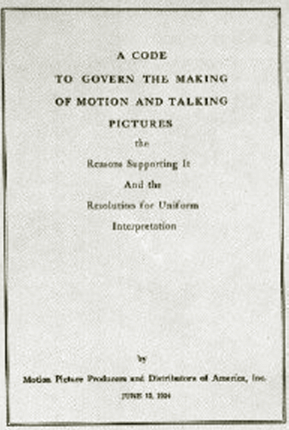
Lock Picking in Movies
Genuine lock picking in movies used to be prohibited
Before 1967, the Hays code (Motion Picture Production Code) required censorship of Hollywood movies
“All detailed (that is, imitable) depiction of crime must be removed, such as lock picking or mixing of chemicals to make explosives”
Public domain image from http://commons.wikimedia.org/wiki/File:Motion_Picture_Production_Code.gif

Slide 10
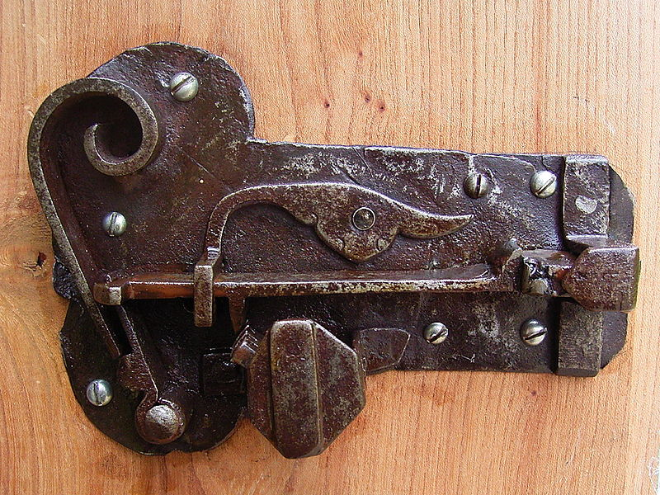
LOCK TYPES
Image from http://commons.wikimedia.org/wiki/File:Ancient_warded_lock_open.jpg used with permission under Gnu Free Documentation License 1.2

Slide 11

TSA Lock
The U.S. government has established a set of rules for the inspection of baggage without the presence of passengers
Special TSA-approved locks allow both inspection and some protection against theft
An important element is that the inspection must be easily verifiable by the user
Public domain government image
Do the TSA locks keep your belongings safe?

Slide 12
Define “ward”
a. The projecting ridge of a lock or keyhole that prevents the turning of a key other than the proper one.
b. The notch cut into a key that corresponds to such a ridge.

Slide 13
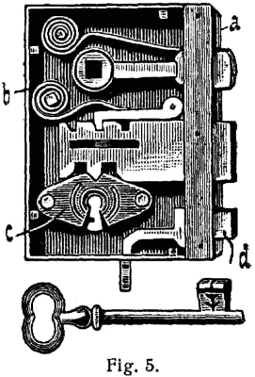
Warded Locks
Locks of this type were used in ancient times
The key moves the bolt assisted by a support spring
Security relies on the fact that not all keys pass through the key hole
http://en.wikipedia.org/wiki/Warded_lock
Notes:
Usually in old style doors or desks
Different concentric obstructions
Easy to lock pick with Skeleton keys

Slide 14
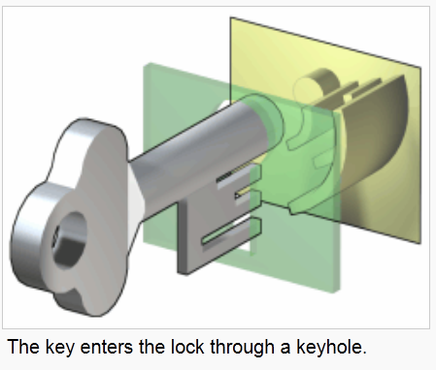
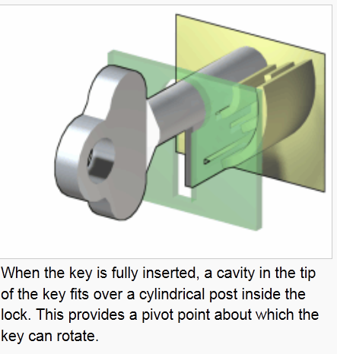
How a Warded Lock Works
http://en.wikipedia.org/wiki/Warded_lock

Slide 15
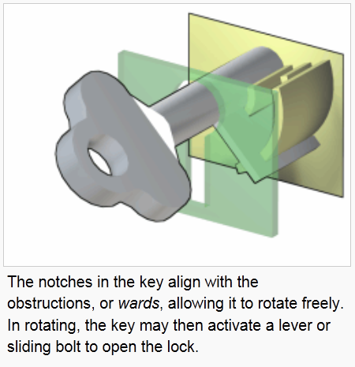
How a Warded Lock Works
http://en.wikipedia.org/wiki/Warded_lock

Slide 16
Use of Warded Locks Today
Large warded locks are still in use today in the UK and Ireland for internal and external doors.
Warded locks in America are commonly used in inexpensive padlocks, cabinet locks, and other low-security applications, since a well-designed skeleton key can successfully open a wide variety of warded locks.

Slide 17
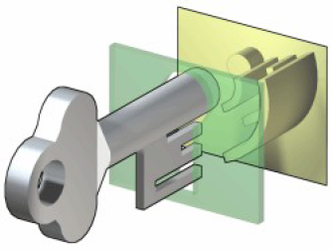
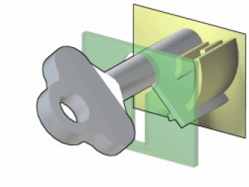
Skeleton Key
Usually for old style doors or desks
Different concentric obstructions
Easy to lock pick with Skeleton keys
They were first used in ancient Rome
Images from http://en.wikipedia.org/wiki/File:Warded_locked.png used by permission under Gnu free documentation license 1.2

Slide 18
A skeleton key is one that has been filed or cut so that it can be used to unlock a variety of warded locks each with a different configuration of wards.
This can usually be done by removing most of the center of the key, allowing it to pass by the wards without interference, unlocking or locking the lock.
To counteract this, wards can be placed not just in the center but on the outside as well, making attempts at making a successful skeleton key harder.

Slide 19
Pick vs. Bypass
Breaking open a lock in a nondestructive manner can be achieved either through:
Picking: acting on the lock mechanism simulating the operation of the key
Bypassing: manipulation of the bolt without using the lock

Slide 20

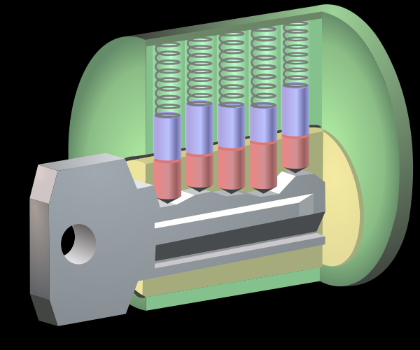
1860: Yale Pin Tumbler Lock
Modern version of the Egyptian single-pin design
Utilizes two pins for locking
Public domain image of Linus Yale, Jr.
Double-detainer theory of locking
Created shear line
Image from http://en.wikipedia.org/wiki/File:Pin_tumbler_with_key.svg used with permission under Gnu Free Documentation License 1.2

Slide 21
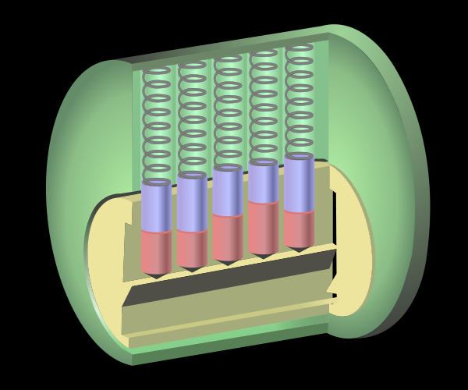
Terminology (Warded Lock)
driver
shell or hull
top or driver
tumbler spring
pin
sheer line
bottom or key
cylinder or plug
keyway
Image from http://en.wikipedia.org/wiki/File:Pin_tumbler_with_key.svg used with permission under Gnu Free Documentation License 1.2

Slide 22
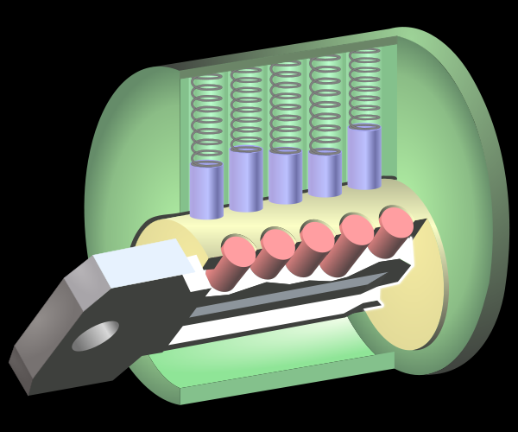
How Does a Pin Tumbler Lock Work?
When a key is not present, the pin stacks are pushed down by the springs so that the driver (top) pins span the plug and the outer casing, preventing the plug from rotating.
When the correct key is inserted, the ridges of the key push up the pin stacks so that the cuts of the pin stacks are aligned with the shear line.
The alignment of the cuts with the shear line allows the plug to be rotated.
Images from http://en.wikipedia.org/wiki/File:Pin_tumbler_with_key.svg used with permission under Gnu Free Documentation License 1.2

Slide 23
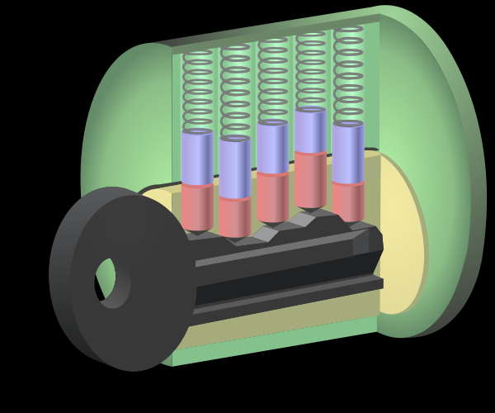
How Does a Pin Tumbler Lock Work?
If an inappropriate key is insered, then the pins do not align along the shear line and the lock does not turn.
Image from http://en.wikipedia.org/wiki/File:Pin_tumbler_with_key.svg used with permission under Gnu Free Documentation License 1.2

Slide 24
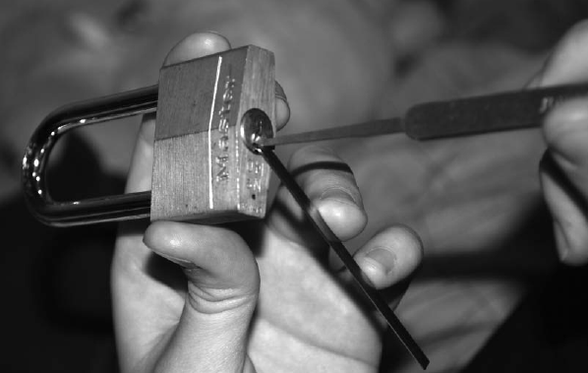
LOCK PICKING
Photo by Dan Rosenberg included with permission.

Slide 25
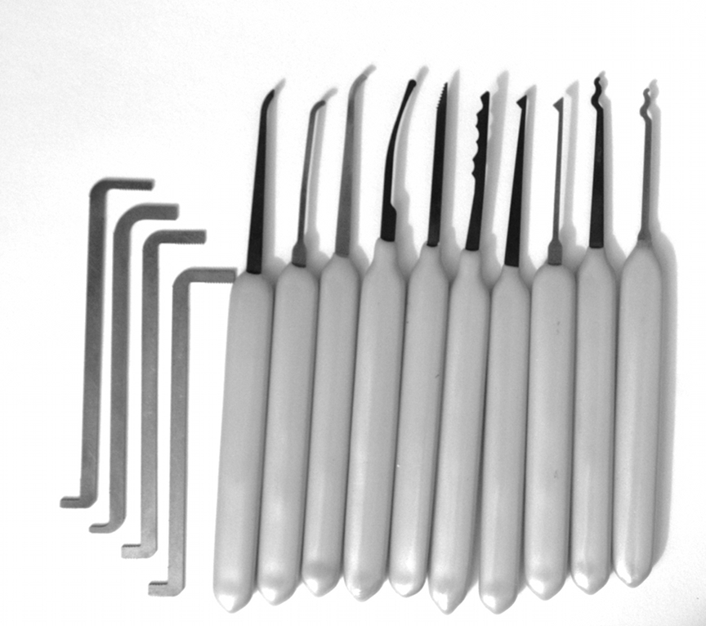
Lockpicking Tools
Feelers
Scrubbers
Tension tools
Photo by Jennie Rogers included with permission.

Slide 26
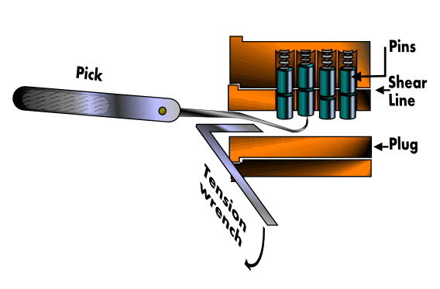
Feeler Picking
Apply light tension
Lift one pin at a time
Identify binding pin
Lift binding pin until it reaches the shear line
Setting the binding pin will rotate the lock slightly
Find next pin and repeat the process
Image from http://commons.wikimedia.org/wiki/File:Pin_and_tumbler_lock_picking.PNG used with permission under Gnu Free Documentation License 1.2

Slide 27
Scrubbing / Raking
Apply light tension
Work over pins back to front in a circular motion
attempting to pop them into the shear line with the combination of tension
Good for beginners
Usually employ snake pick or half diamond
Photo by Jennie Rogers included with permission.

Slide 28
The Math of Lock Picking
Suppose we have
40 different kinds of key blanks
7 pin positions
8 different possible pin heights
Then the total number of possible locks is
40 x 8⁷ = 83,886,080
Not all these are possible, however, as it is difficult to put long teeth next to small teeth.

Slide 29
Rights Amplification in
Master Keyed Systems
Reverse engineer master key from change key
Each lock has P pins, with D potential cut heights
Create D-1 test keys for each pin position p
Cut all pin positions except p as known change key
Published by Matt Blaze at Penn

Slide 30
Rights Amplification (continued)
Query the lock until you find each pin position
i.e. To determine first key cut depth insert each of the D-1 test keys and determine which one does not bind to the pin
Repeat for each pin

Slide 31
Rights Amplification Statistics
Consumes P(D-1) blanks
Can reduce to P blanks and file down on the fly
But this looks suspicious
Search space is practically pruned by manufacturer specs
maximum distance limit in legal adjacent cuts
Older installations sometimes require MKs to be higher on the pin stack

Slide 32
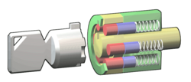
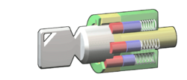
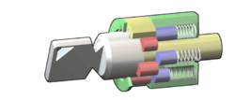
Tubular lock
Usually on car alarms or vending machines
6-8 pins
Easy to pick with special tool
The tool could become a new key
Images from http://en.wikipedia.org/wiki/File:Tubular_locked.png used with permission under Gnu Free Documentation License 1.2

Slide 33
Statistics
4-6 pins, 4-10 levels
10⁶ = 1,000,000 possible keys!
The angular positions of the cylinders allow to obtain about 180 different positions (180⋅10)⁶ = 3.4012224 × 10¹⁹
(Un) fortunately there is a need for some tolerance in locks
Notes:
33

Slide 34
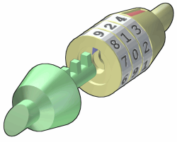
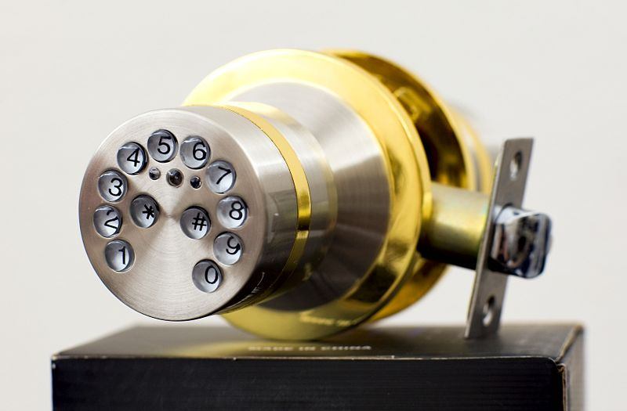
Combination Locks
There are locks that do not require a physical key to be opened but a code
Number of combinations is
Number of digits
times
Length of combination
Images from http://en.wikipedia.org/wiki/File:Combination_unlocked.png and
http://commons.wikimedia.org/wiki/File:Electronic_lock_yl88.jpg used with permission under Gnu Free Documentation License 1.2

Slide 35
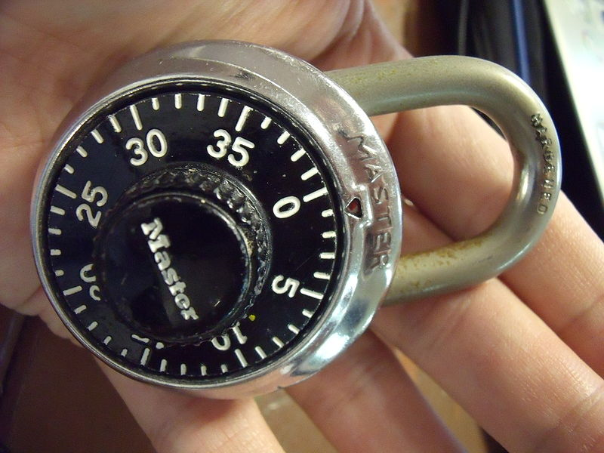
Combination Locks
Inexpensive combination padlocks allow attacks based on reducing the space of possible combinations to try
The gears have a higher tolerance of the external disk combination
Nominal number of combinations is 40³ = 64,000
Possibilities can be reduced to about 80 by detecting critical gear points
Public domain image from http://commons.wikimedia.org/wiki/File:Lock.JPG
E.g., see http://www.wikihow.com/Crack-a-%22Master-Lock%22-Combination-Lock

Slide 36
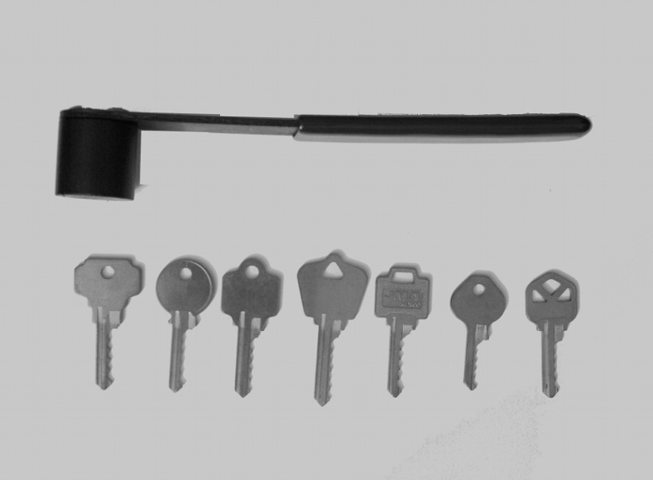
Bumping
A different way of picking locks
Virtually all traditional Yale and similar locks can be opened by bumping
What lock pickers say about bumping:
RELIABLE
REPEATABLE
SIMPLE TO LEARN
Photo by Jennie Rogers included with permission.

Slide 37
Bump Keys
Driver pins “jump” higher than the cylinder just for an instant
If a light rotational force is applied, the cylinder will turn
Lock bumping is a very fast method for opening the lock
The lock is not damaged in any way
Few key-pin locks cannot be bumped
Photo by Jennie Rogers included with permission.

Slide 38
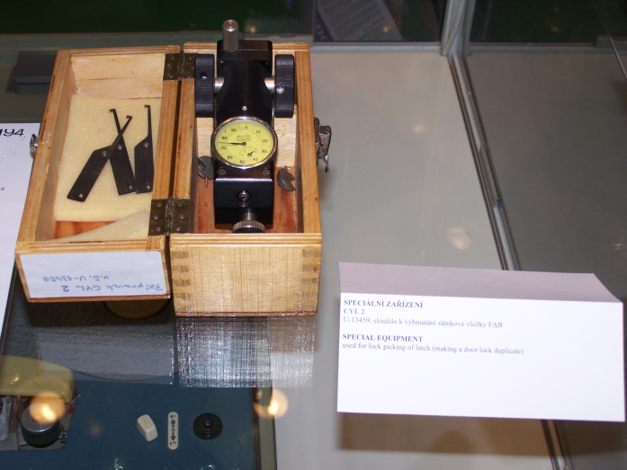
Pick Gun
Manual and electronic pick guns are a popular method for quick and easy ways of opening up doors
The pick gun is used in a similar way but usually has a trigger that creates an upward movement that must be repeated rapidly to open the lock
Public domain image from http://en.wikipedia.org/wiki/File:IDET2007_lock_picking_device.jpg

Slide 39
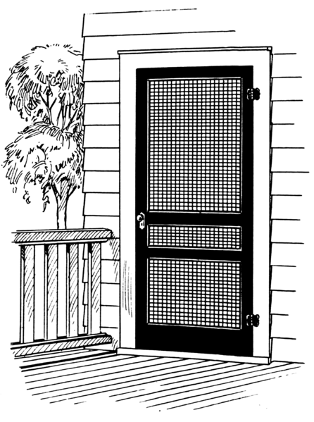
Side Channel Attacks
Cheap hinges
Rather than attempting to directly bypass security measures, an attacker instead goes around them by exploiting other vulnerabilities not protected by the security mechanisms.
Side channel attacks are sometimes surprisingly simple to perform.
High security lock
Public domain image by Pearson Scott Foresman from http://en.wikipedia.org/wiki/File:Screen2_%28PSF%29.png

